Slide 1


Chess Book For Beginners by MY Chess zone

Slide 2
Content
1. Chess pieces namE
2. chess pieces symbol
3. chess pieces points
4. chess board setup
5. chess notation
6. chess ranks and files
7. chess pieces movement
8. what is attack & check
9. what is capturing
10. what is checkmate
11. special moves
12. type of draws
13. defending in chess
14. hanging pieces
15. how to save against check
16. how to improve in chess
17. checkmate with different pieces

Slide 3
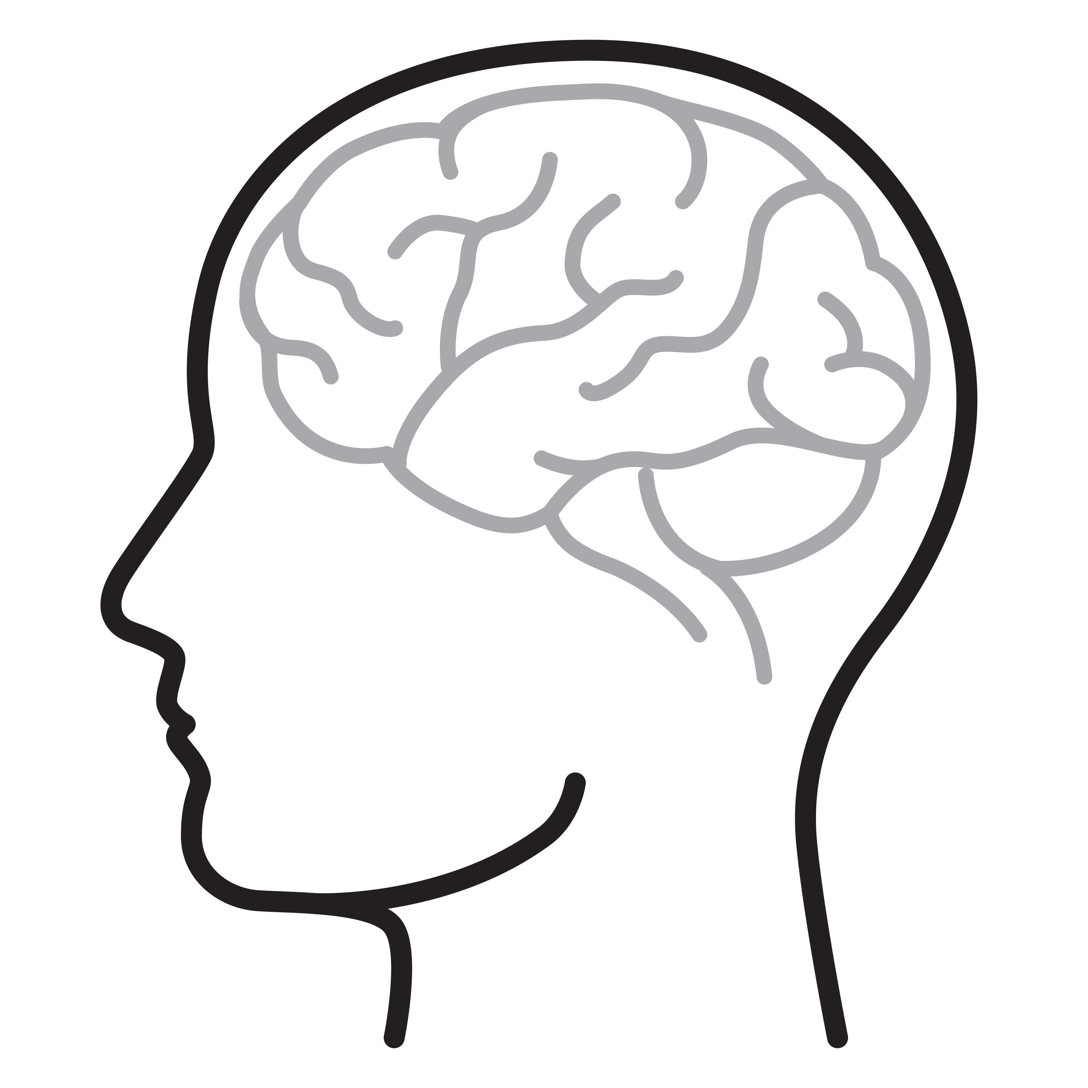
CHESS History AND BENEFITS
Raises IQ
Improves problem solving skill
Improves willpower and patience
Improves concentration
Optimize memory
The history of chess can be traced back nearly 1500 years to its earliest known processor called chaturanga in India.
Chess is widely regarded as a captivating and intellectually stimulating game. However, many children are not acquainted with the correct rules and strategies.
The game of chess offers valuable lessons in focus, handling pressure and enhancing memory skills. It provides an ideal platform for personal growth and cognitive development. With the aid of this book, aspiring chess enthusiasts can attain mastery over the fundamentals of this game.

Slide 4
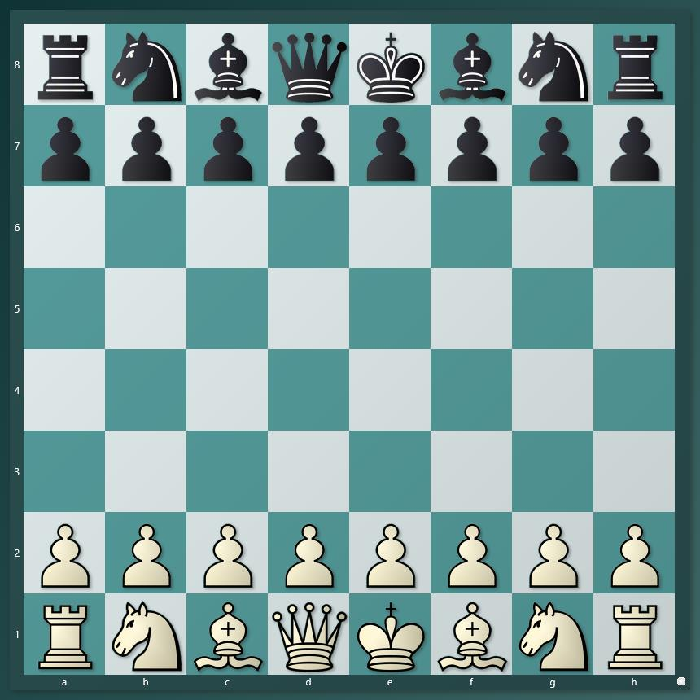
CHESS BOARD
Chess is a two players game played on a 64 squares chess board.
The aim of the chess game is to checkmate opponent king.
There are total of 16 white and 16 black pieces on the chess board.
Chess board need to placed correctly in front of both the players. White side right corner square should be white.

Slide 5
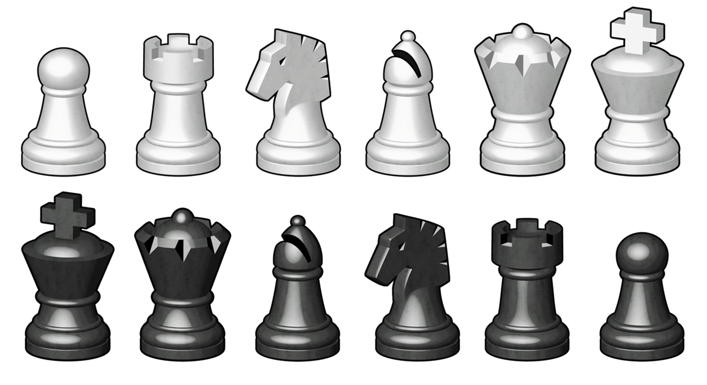
Chess pieces name
PAWN
KNIGHT
BISHOP
ROOK
QUEEN
KING

Slide 6
Chess pieces SYMBOL
PAWN
KNIGHT
BISHOP
ROOK
QUEEN
KING
No symbol
N
B
R
Q
K

Slide 7
Chess pieces POINTS
PAWN
KNIGHT
BISHOP
ROOK
QUEEN
KING
1
3
3
5
9
INFINITY

Slide 8
How to setup chess board
Queen starts on the square of her own color
Both kings in against of each other
White square on the right

Slide 9
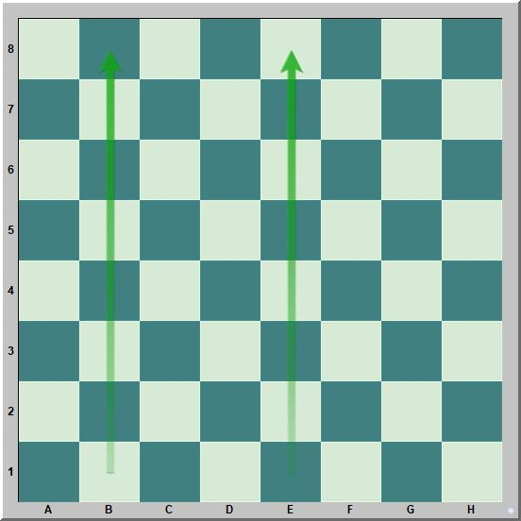
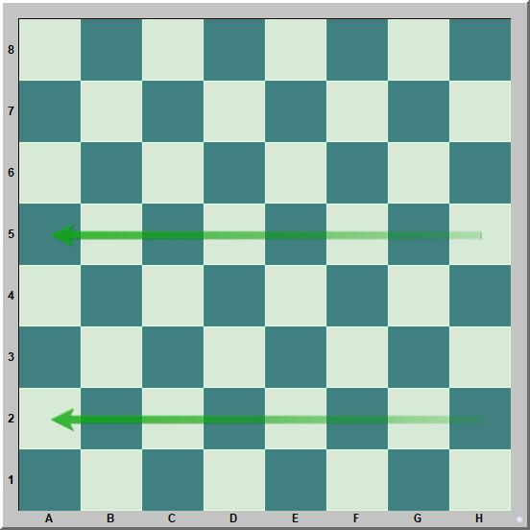
FILES & RANKS
A file is a vertical line that runs from the top to bottom or from bottom to top.
These are “b” and “e” file.
A rank is a horizontal line that runs from the left to right or from right to left.
These are “2” and “5” rank.

Slide 10
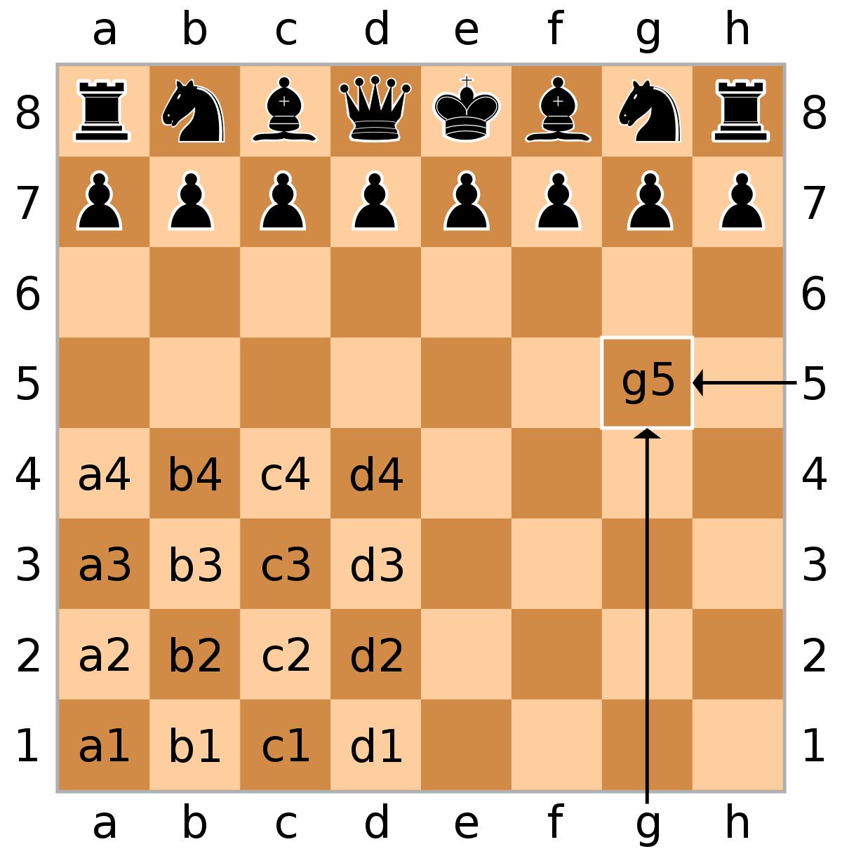
Square name and notation
Chess notations are used to read and write down the chess moves.
With the help of Files (alphabets) and Ranks (horizontal) we denote a square name.
To record a chess move, we utilize the symbol representing the respective piece followed by the square name to which is moved. For instance, if a queen is moved to the f3 square, we would denote it as Qf3.
When a chess piece captures an opponent piece while moving, the notation includes the symbol “x” to indicate the capture. For instance, if a queen captures an opponent’s piece on f3 square, it would be recorded as Qxf3.

Slide 11
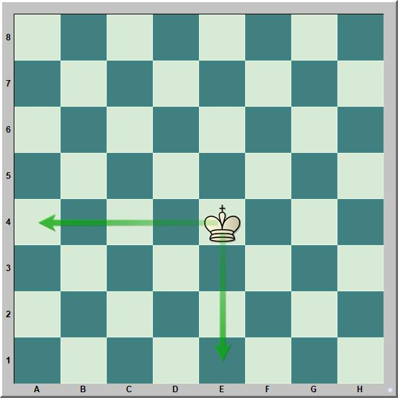
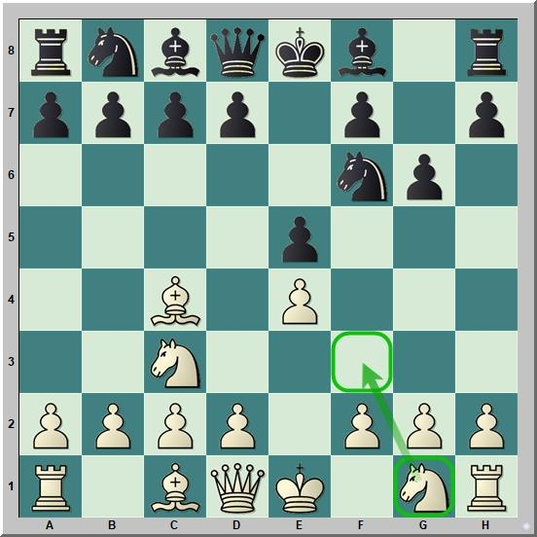
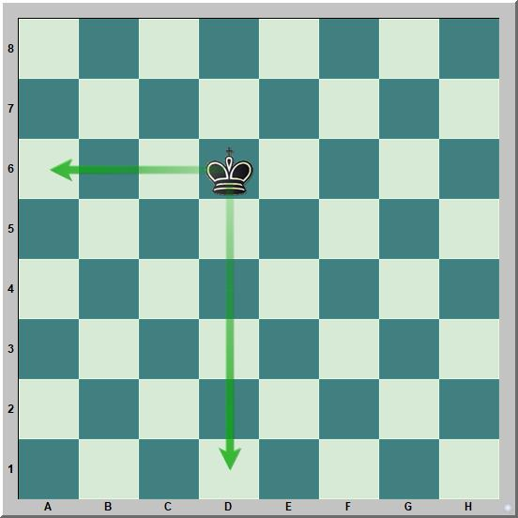
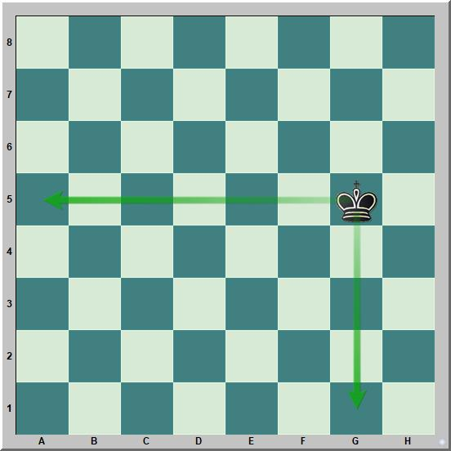
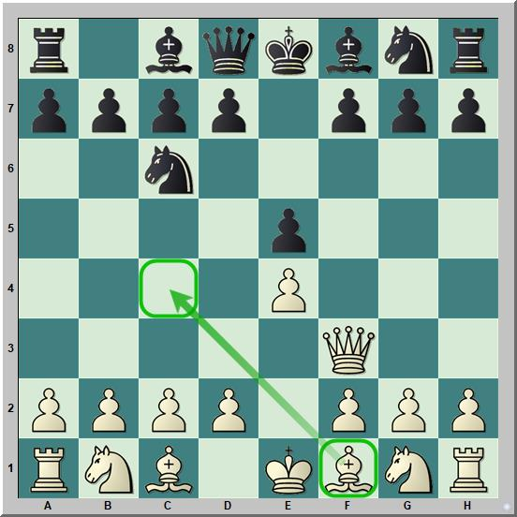
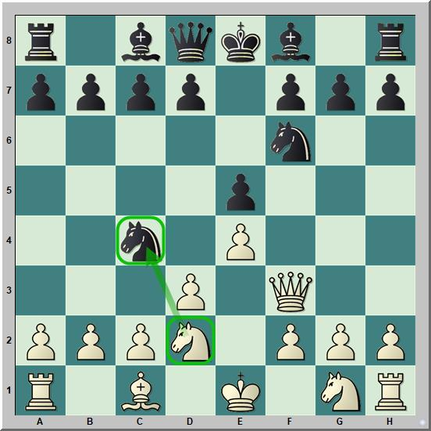
Notation
Answer:
e4
Answer:
Nf3
white king is placed on which square ?
write down the white knight move
Answer:
Answer:
black king is placed on which square ?
black king is placed on which square ?
Answer:
Answer:
write down the white move
write down the white knight move

Slide 12
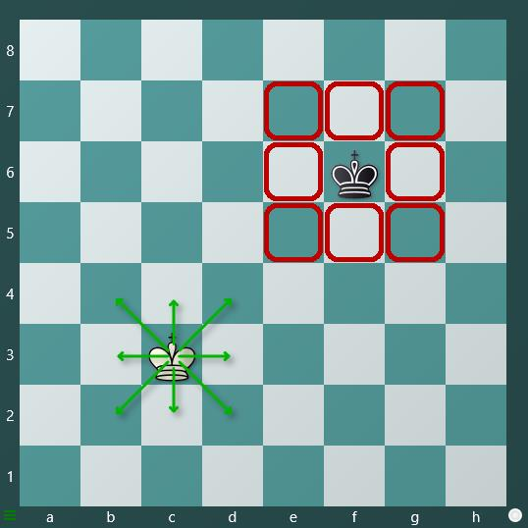
Chess pieces Movement
King
The king is the most important piece in the chess game. A player’s primary objective is to safeguard their king throughout the entire game.
King can only move one step in every direction: up, down, left, right, and diagonally.
During castling, the king can move 2 steps.

Slide 13
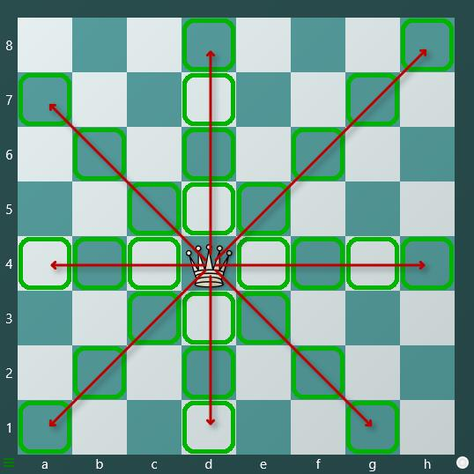
Chess pieces Movement
QUEEN
The queen is the most powerful piece in the chess game. The queen is a most previous piece after the king.
The queen can move any number of step in every direction, up, down, left, right, and diagonally.
At times we can say, that the queen combines the moving powers of both the rook and bishop.
Queen cannot jump over their own pieces or those of the opponent."

Slide 14
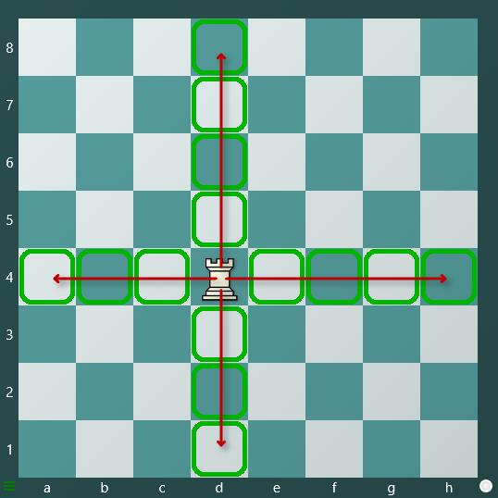
Chess pieces Movement
ROOK
The rook is the most powerful piece of the chess game after queen.
The rook can move any number of step in every horizontal and vertical lane.
Rook cannot jump over their own pieces or those of the opponent."

Slide 15
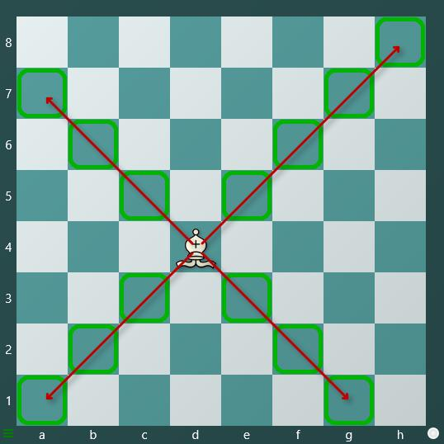
Chess pieces Movement
BISHOP
A bishop can move any number of squares in a diagonal, either forward or backward direction.
Bishops are especially effective for executing double attacks or creating pins in the chess game.
Bishops always remain on the same color square they start on.
Bishops cannot jump over their own pieces or those of the opponent."

Slide 16
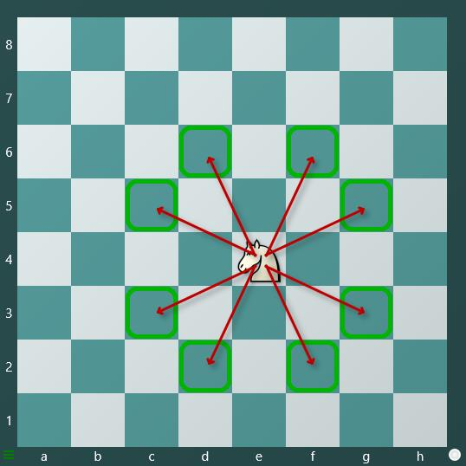
Chess pieces Movement
KNIGHT
The knight moves in the shape of a capital L.
It moves either two squares vertically and one square horizontally or two squares horizontally and one square vertically.
The knight is the only piece that can jump over both its own and opponent's pieces.
Knights are effective at creating double attacks or forks in chess

Slide 17
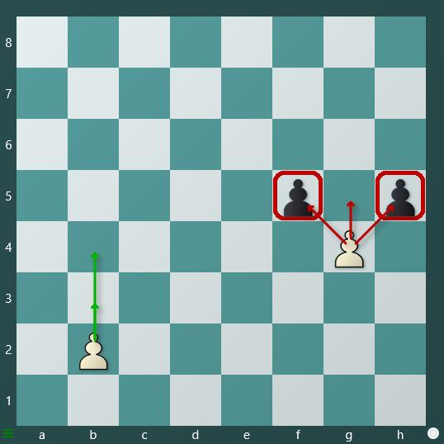
Chess pieces Movement
PAWN
A pawn can move one or two steps forward if it's its first move; afterward, it can only move one step at a time.
Pawns cannot move backward.
Pawns capture opponent pieces by moving one step diagonally forward.
Pawns cannot jump over their own pieces or those of their opponent.

Slide 18
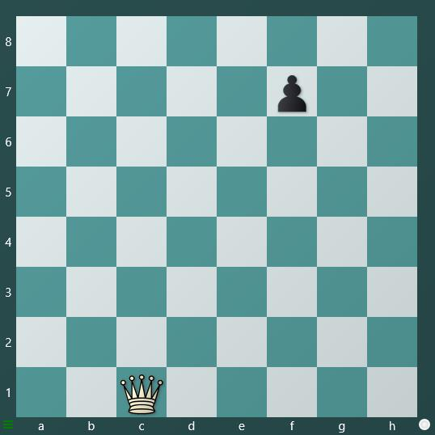
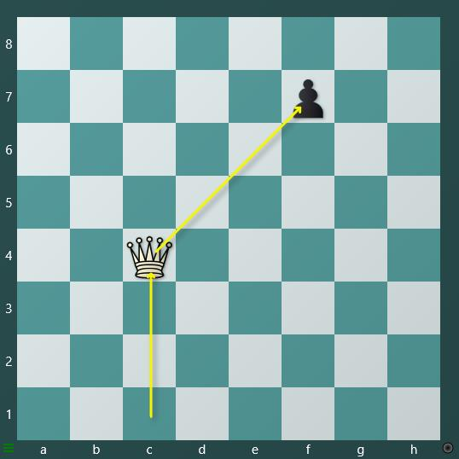
Basic Attack
An attack on a chess piece is a move that creates the possibility of capturing that piece on the next move.
In the two pictures below, you will see how White is attempting to launch an attack to capture the black pawn.
Example
In this example, you can observe that the white queen is positioned on the c1 square, and there's a black pawn on the f7 square. White's objective is to launch an attack on the black pawn, and to achieve this, the queen its moved from c1 to c4 square.

Slide 19
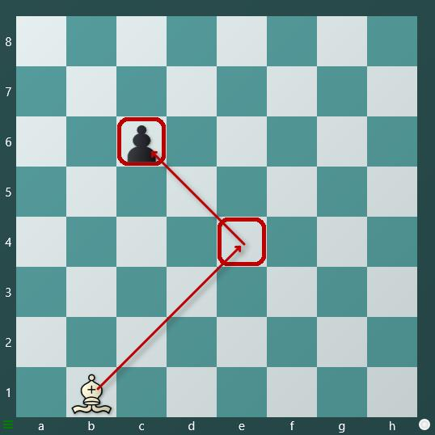
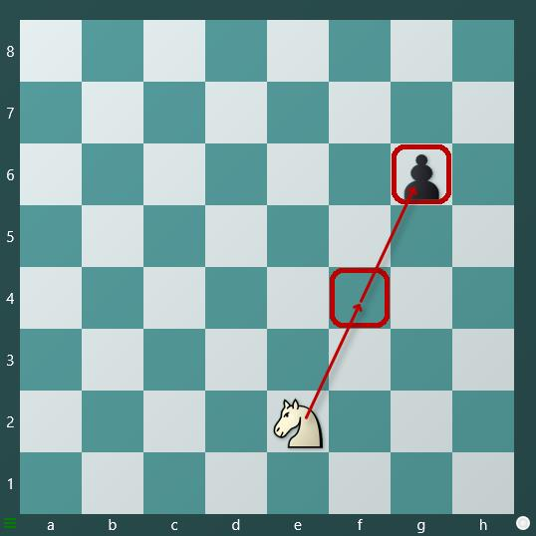
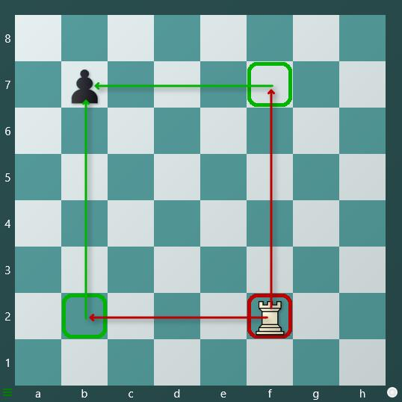
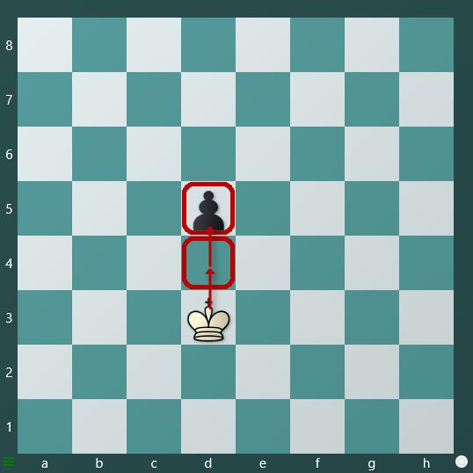
Basic Attack
White moves its Bishop from b1 to e4 to attack black pawn.
White moves its Knight from e2 to f4 to attack black pawn.
White moves its Rook from f2 to b2 or f7 to attack black pawn.
White moves its King from d3 to d4 to attack black pawn.

Slide 20
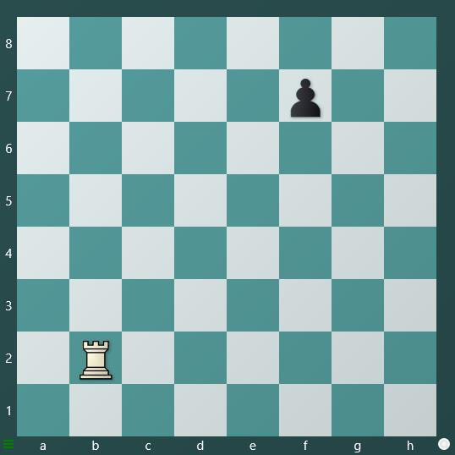
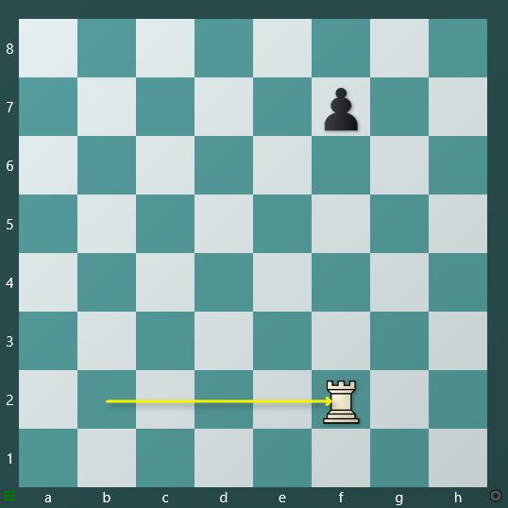
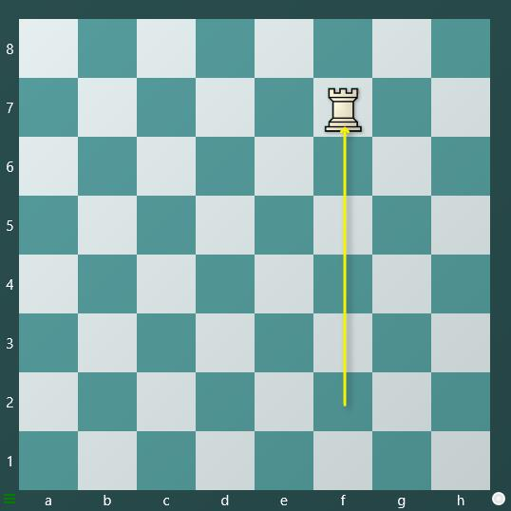
Basic capture
When a chess piece can move to a square occupied by an opponent's piece and remove that piece from the board, it is referred to as a capture.
Pieces can capture opponents by moving to the squares occupied by those opponent pieces.
Example
In this example, you can observe that the white rook positioned on b2 intends to capture the black pawn on f7. White accomplishes this by moving the rook from b2 to f2, and then capturing the pawn on f7.

Slide 21
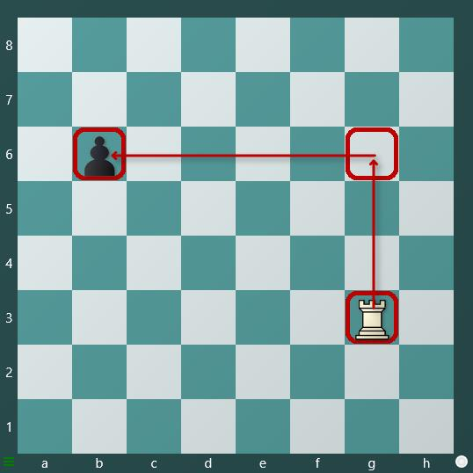
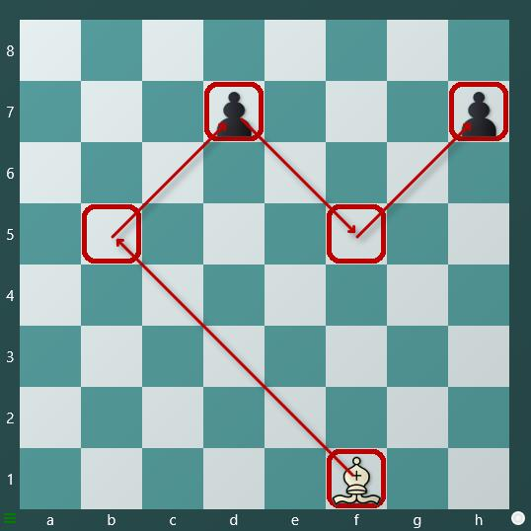
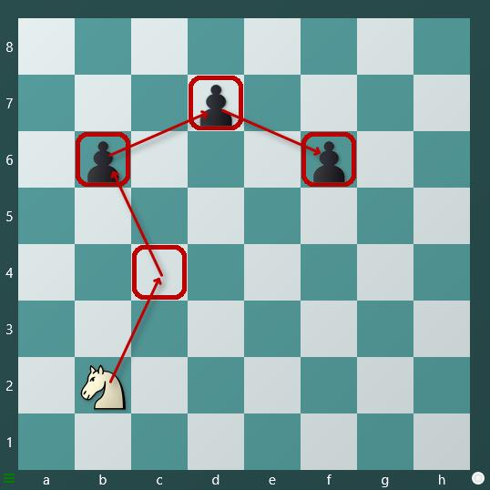
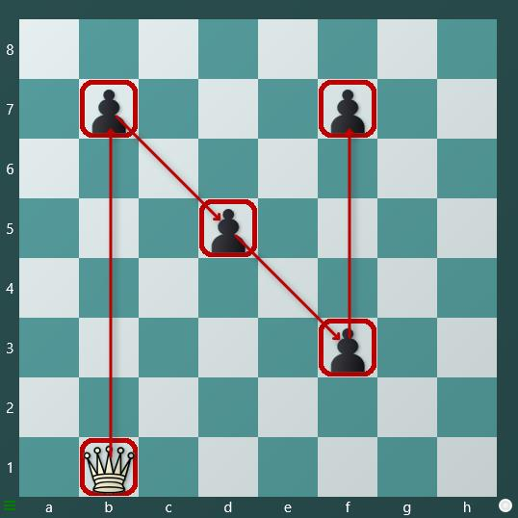
Basic capture
White moves its Rook from g3 to g6 and then b6 to capture black pawn.
White moves its Bishop from f1 to b5 to d7 to f5 and h7 to capture black pawns.
White moves its Knight from b2 to c4 to b6 to d7 and f6 to capture black pawns.
White moves its Queen from b1 to b7 to d5 to f3 and then f7 to capture black pawn.

Slide 22
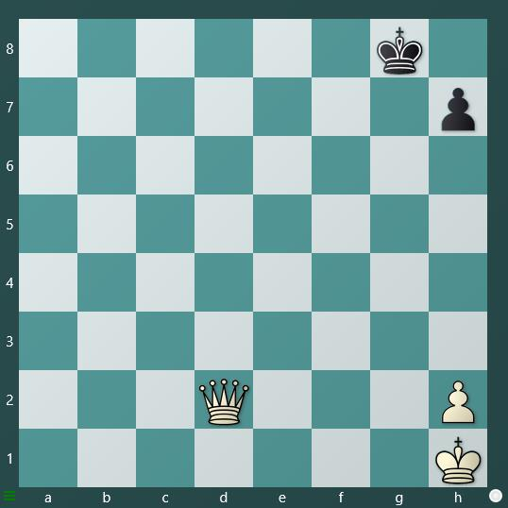
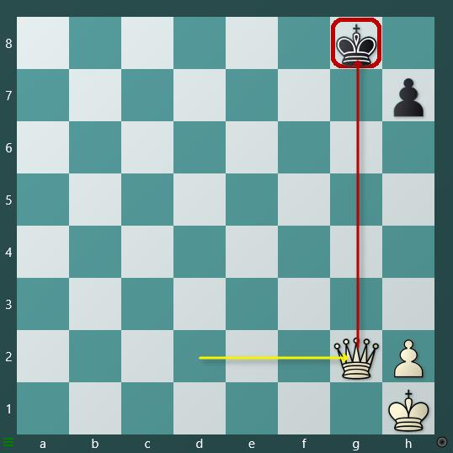
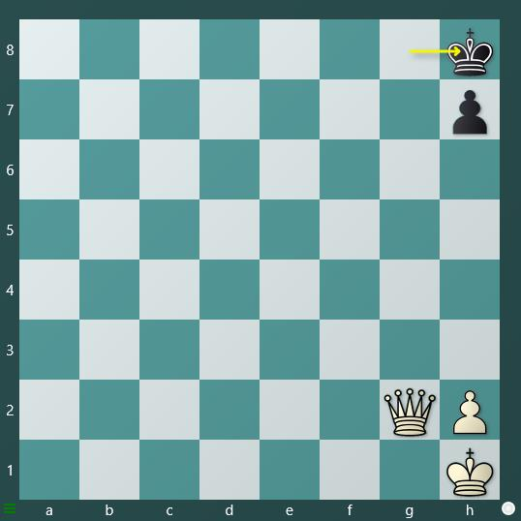
Check
In chess, a check is a situation in which one player makes a move that threatens the opponent's king.
If a player's king is in check, they are required to get out of check to continue the game. Making any other move when the king is in check is considered an illegal move and cannot be played in the game.
Example
In this example, you can observe that the white queen on g2 is attacking the black king on g8. Black moves its king to h8 to protect the king and escape from check.

Slide 23
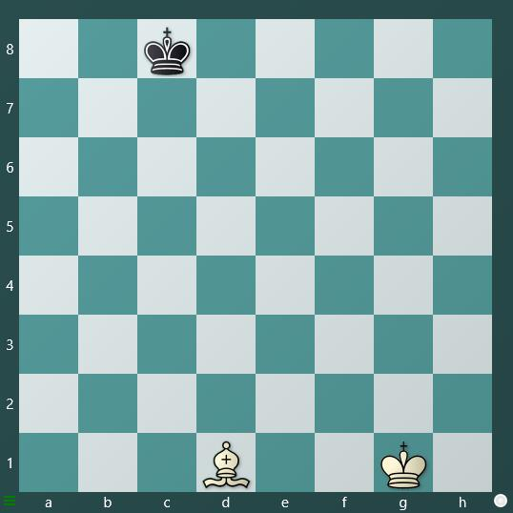
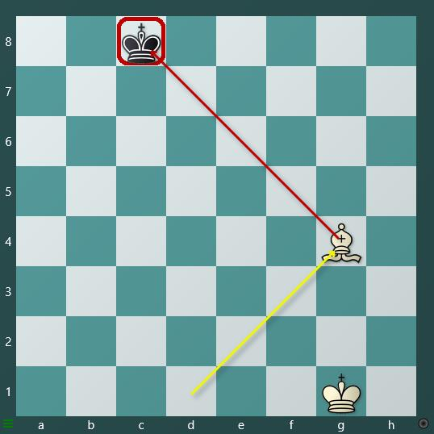
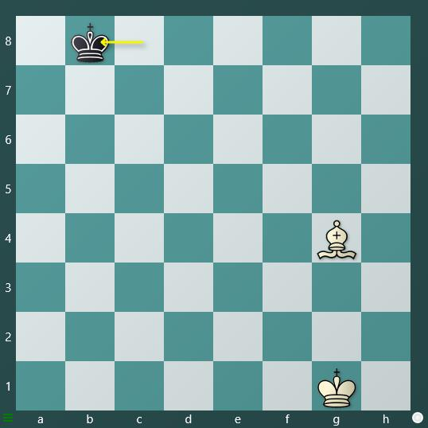
check
How to get out of check
There are three ways to get out of check
Moving the king to safety:
Move the king to a safer square where there is no threat.
Capture the threating piece:
Capture the piece that is threatening the king.
Block the check:
Use another piece to block the check.
a. Moving the king to safety
In this example, you can observe that the white bishop is on d1, and the black king is on c8. White moves its bishop to g4 to threaten the black king. In response, the black player employs a strategy of moving the king to safety, shifting it to b8 to get out of check.

Slide 24
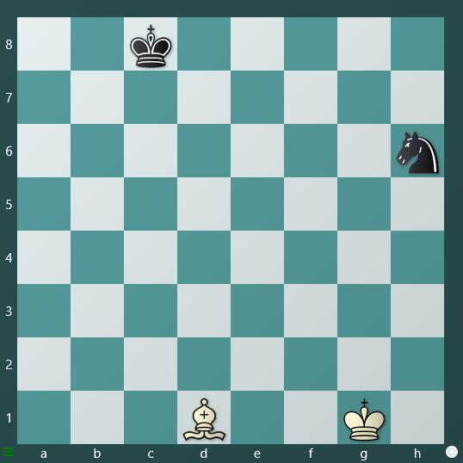
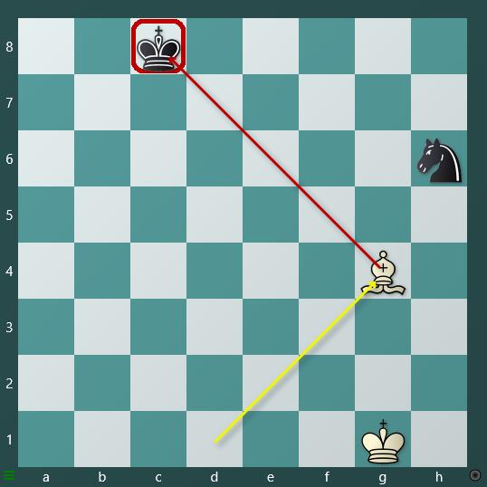
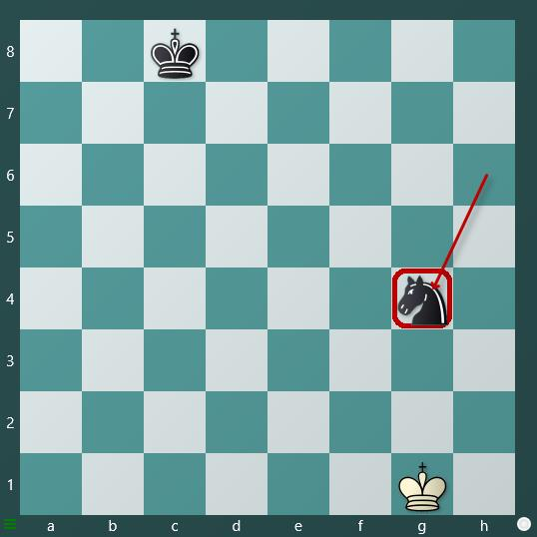
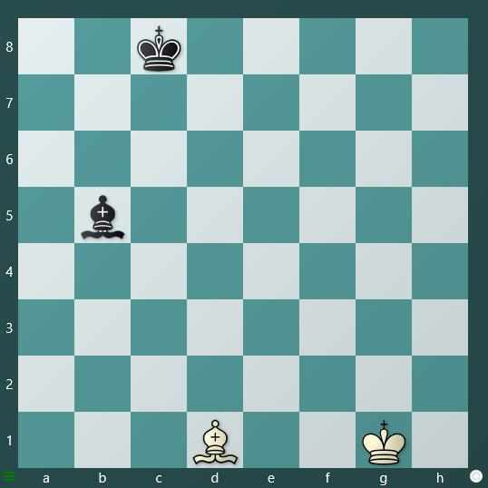
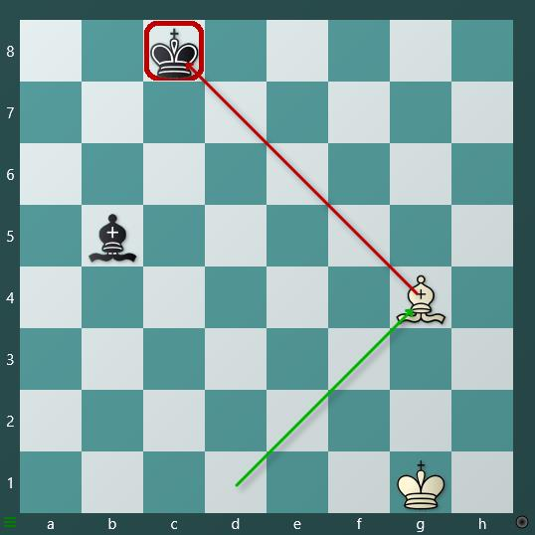
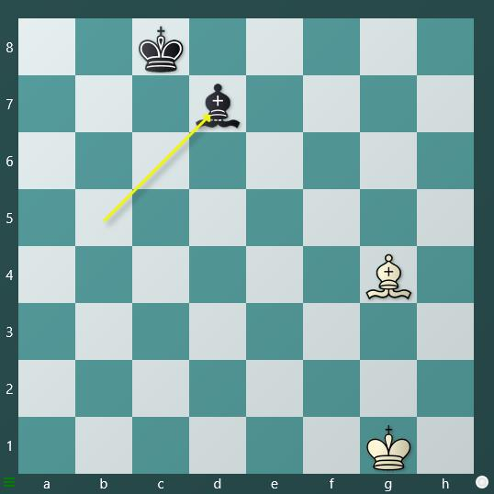
How to get out of check
b. Capture the threating piece
In this example, you can observe that the white bishop is on d1, and the black king is on c8. White moves its bishop to threaten the black king. In response, the black player employs a strategy of capturing the threatening piece and plays Knight takes g4 to capture the white bishop.
c. Block the check
In this example, you can observe that the white bishop is on d1, and the black king is on c8. White moves its bishop to g4 to threaten the black king. In response, the black player employs a strategy of blocking the check, playing Bishop to d7 to get out of check.

Slide 25
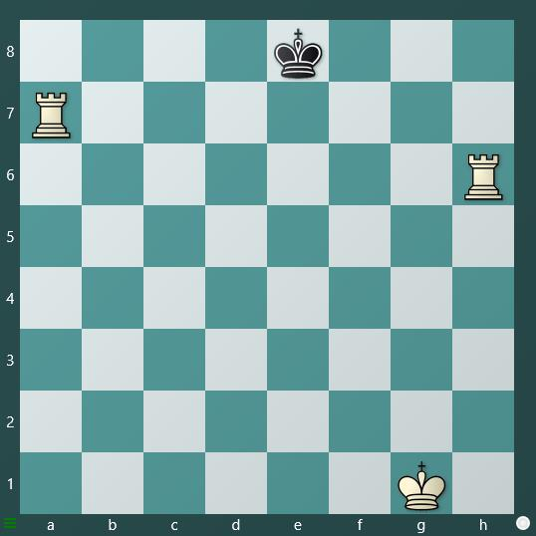
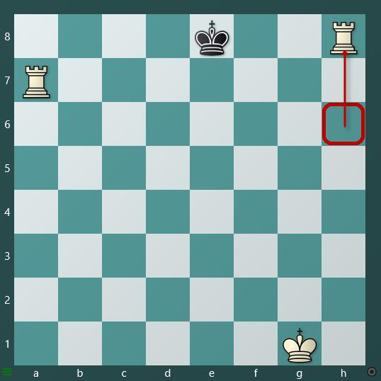
WHAT IS CHECKMATE
Checkmate happens when a king is in danger, known as check, and there is no legal move for it to get away from the threat. This means the game ends, and the player who put the opponent's king in checkmate wins.
Example
In this example, notice the white rook at h6. It moves to h8, placing the black king in checkmate. The black king can't move to a safe square, capture the white rook on h8, or block the check with any black piece. This means the game is over, and white wins.

Slide 26
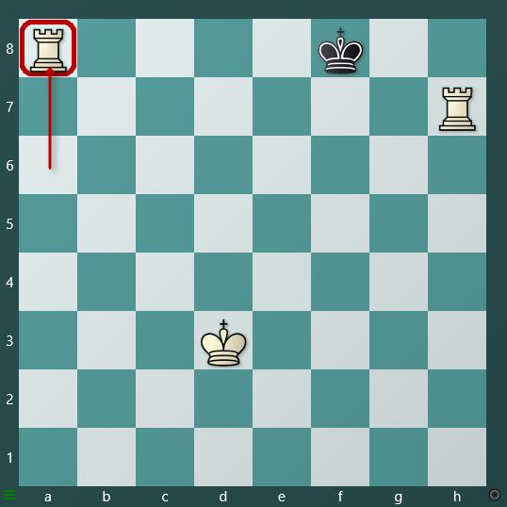
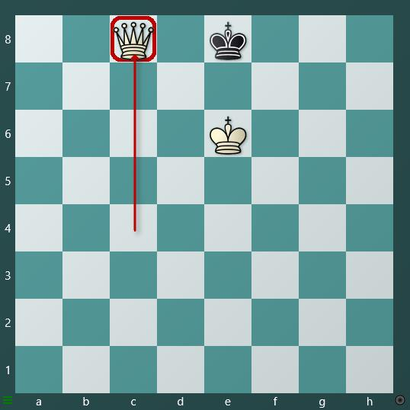
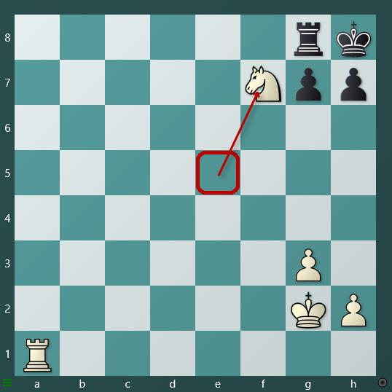
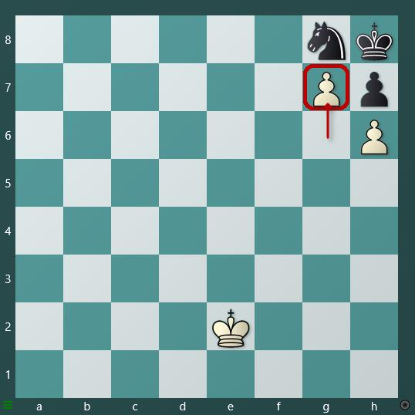
CHECKMATE
White moves its Rook from a6 to a8 and checkmate the black king
White moves its Queen from c4 to c8 checkmate the black king
White moves its Knight from e5 to f7 and checkmate the black king
White moves its pawn from g6 to g7 and checkmate the black king

Slide 27
Special moves
Checkmate happens when a king is in danger, known as check, and there is no legal move for it to get away from the threat. This means the game ends, and the player who put the opponent's king in checkmate wins.
A special move in chess is a unique action that allows players to make a move distinct from simply moving pieces or capturing them
There are three types of special moves in chess:
Castling: Castling allows players to move their king and rook together, positioning them on specific squares relative to each other based on the player's choice of short or long castling
En-passant: En-passant allows either the white or black player to capture an opponent's pawn sideways on the 5th or 4th rank, depending on whose turn it is. However, players must adhere to specific rules before executing the en-passant maneuver.
Pawn promotion: Pawn promotion is a special move that allows players to promote their pawn into a queen, rook, knight, or bishop according to the player's choice.

Slide 28
WHAT IS CASTLING
Castling is a special move in chess that involves the king and one rook. It is the only move in chess where a player can move two pieces at once.
🔹 How it works:
The king moves two squares to the left or right.
The rook jumps over the king and lands next to it.
🔹 There are two types:
Kingside castling (O-O): King moves toward the rook on the kingside (short side).
Queenside castling (O-O-O): King moves toward the rook on the queenside (long side).
✅ Conditions for Castling:
Castling is only legal if:
The king and rook involved have never moved before.
There are no pieces between the king and rook.
The king is not in check.
The king does not pass through a square that is under attack.
The king does not end up in check after castling.
🎯 Why is castling important?
Safety: Moves the king to a safer position.
Development: Brings the rook into the center, ready to play.
Strategy: Often a key milestone in opening play.

Slide 29
Castling Examples
Example 1: In the first example, White moves the king from e1 to g1 and the rook from h1 to f1, completing short castling.
Example 2: In the second example, White moves the king from e1 to c1 and the rook from a1 to d1, completing long castling.
Example I
Example II
Game Dynamics:
Short castling is common in open games (e.g., 1. e4 e5) where quick development and king safety are priorities.
Long castling is common in closed or semi-open games (e.g., 1. d4 or 1. c4) where players aim for rapid rook activation on the d-file or queenside attacks.
Safety and Strategy:
Short castling is often quicker and safer because fewer pieces need to move (only the knight and bishop), and the king is tucked behind a solid pawn structure (f2, g2, h2).
Long castling often requires moving more pieces (knight, bishop, and queen) and can expose the king if the queenside pawns (a2, b2, c2) are advanced or attacked.

Slide 30
WHAT IS Pawn promotion
Pawn promotion in chess happens when a pawn reaches the opposite end of the board (the 8th rank for White or the 1st rank for Black).
At that moment, the pawn must be promoted into another piece — queen, rook, bishop, or knight — regardless of what pieces are still on the board.
Example
Most common promotion: to a queen (called queening) because it’s the most powerful piece.
Special cases: sometimes players choose a knight, rook, or bishop (called underpromotion) to avoid stalemate, checkmate faster, or create tactical advantages.

Slide 31
WHAT IS En-passant
En passant is a special pawn capture in chess.
It happens when:
A pawn moves two squares forward from its starting position (on its first move).
If it lands next to an opponent’s pawn, that opponent has the right to capture it as if it had only moved one square forward.
This capture must be done immediately on the next move; otherwise, the right is lost.
Example
✅ Example:
White pawn is on e5.
Black pawn moves from d7 to d5 (two steps forward).
White can capture the black pawn by moving exd6 en passant.

Slide 32
WHAT IS exchange
An exchange means trading pieces of (usually) equal value. For example:
You capture your opponent’s bishop, and your opponent recaptures with their pawn.
Or you take their rook, and they take your rook.
Example I
Example II
📌 Tip to Remember
Pawn = 1 point
Knight = 3 points
Bishop = 3 points
Rook = 5 points
Queen = 9 points
So whenever you exchange, check the piece value + position.

Slide 33
Favourable & unfavourable exchange
Favourable Exchange
An exchange is Favourable when you gain more than you lose in terms of piece value or position.
Example: You trade your knight (3 points) for your opponent’s rook (5 points).
Example: You give up a bishop but capture a queen.
Example I
Example II
Unfavourable Exchange
An exchange is Unfavourable when you lose more than you gain.
Example: You give up your rook (5 points) for your opponent’s knight (3 points).
Example: You capture a pawn but lose your bishop in return.

Slide 34
Key notes (Exchange)
Piece Value Reference: In chess, approximate piece values are: pawn = 1, knight = 3, bishop = 3, rook = 5, queen = 9. These values help evaluate whether an exchange is favorable or unfavorable in terms of material.
Positional Factors: Beyond material, the value of an exchange depends on the position. For example, trading a bishop for a knight might be favorable in a closed position (where knights are stronger) but unfavorable in an open position (where bishops thrive).
The Exchange: In chess terminology, “the exchange” specifically refers to trading a minor piece (knight or bishop) for a rook. Winning “the exchange” (e.g., a knight for a rook) is favorable, while losing it is unfavorable.
Think about phase of the game:
Opening/Middlegame: Avoid unnecessary exchanges; activity matters more.
Endgame: Simplify when ahead, keep complexity when behind.
King safety → Sometimes exchanging queens is bad if it exposes your king.
Practical Rules of Thumb
Ahead in material? → Trade pieces, not pawns.
Behind in material? → Avoid exchanges; keep queens and pieces on.
Better position? → Only exchange if it doesn’t relieve pressure.
Worse position? → Sometimes exchanging queens reduces the opponent’s attack.

Slide 35
Opening principles
The basic opening principles in chess are fundamental guidelines that help players establish a strong position early in the game. These principles focus on controlling the center, developing pieces efficiently, and ensuring king safety.
Mastering the basic opening principles is the most important step for beginners and intermediate players. Instead of memorizing too many moves, it’s better to understand these universal rules.
Example
Example
e4 e5
Nf3 Nc6
Bc4 Bc5
d3 Nf6
O-O O-O

Slide 36
Key notes (Opening)
🔑 Basic Opening Principles in Chess
1. Control the Center
Place pawns and pieces so they influence the central squares (e4, d4, e5, d5).
Example: Moves like 1. e4 or 1. d4 are popular because they grab space and open lines for your pieces.
2. Develop Your Pieces Early
Get your knights and bishops out quickly.
General rule: Knights before bishops (but depends on position).
Don’t move the same piece twice in the opening unless necessary.
3. King Safety
Castle early (usually kingside) to keep your king safe and connect the rooks.
Avoid weakening your king’s defenses with unnecessary pawn moves.
4. Don’t Move Too Many Pawns
Pawns are important, but moving too many early wastes time.
Focus on piece activity, not just pushing pawns.
5. Don’t Bring the Queen Out Too Early
The queen is powerful but vulnerable.
If you bring it out too soon, your opponent can chase it around while developing their own pieces.

Slide 37
6. Complete Development Before Attacking
Beginners often launch early attacks without development.
A developed army is stronger than a premature attack.
📌 Quick Checklist Before Move 10:
✅ Are your knights and bishops developed?
✅ Is your king safe (castled)?
✅ Do you have control over the center?
✅ Are your rooks connected or almost connected?
Key Notes
Prioritize Development: Aim to get your knights and bishops active and castle within the first 5–10 moves.
Flexibility: These principles are guidelines, not strict rules. Specific openings (e.g., Sicilian Defense, King’s Gambit) may bend them for strategic reasons.
Opponent’s Moves: Always consider your opponent’s threats and adjust your plan to counter them while following these principles.
Example Opening (Italian Game)e4 e5 ,Nf3 Nc6, Bc4 Bc5, d3 Nf6, O-O O-O.
White and Black follow the principles: control the center (e4, e5), develop knights and bishops, and castle early.

Slide 38
Chess puzzles
A chess puzzle is a position taken from a real game (or created) where the player has to find the best move or sequence of moves.
Most common are tactical puzzles like “Mate in 1”, “Mate in 2”, or “Win material”.
🎯Things Kids Should Take Care of While Solving Puzzles
Don’t guess moves → Try to calculate logically.
Slow down → Think, don’t rush to drag pieces.
Look at the whole board → Not just where the action is.
Avoid Tunnel Vision → Don’t get stuck on one idea; consider alternatives.
Learn from mistakes → After solving, review why your wrong move failed.
Spot patterns → Forks, pins, skewers, mating nets keep repeating.

Slide 39
Chess puzzles
🧠 How to Solve a Chess Puzzle?
Identify the Goal
  Is it checkmate, winning material, or saving the position?
  Many platforms tell you (e.g., “White to move and win”).
Check King Safety
  Always check for checks and threats against your king first.
Look for Forcing Moves
  Checks, captures, threats → these limit the opponent’s replies.
Calculate Variations
  Don’t just move the first idea.
  Visualize opponent’s best defense and your reply.
Double-Check Before Moving
  Is your move actually achieving the goal?
  Beginners often stop too early (thinking one check = checkmate).

Slide 40
Chess puzzles
📌Additional Tips for Kids
Use Visual Aids: For younger kids, point out key pieces or squares on the board to focus their attention (e.g., “Look at the Black king. Where can it go?”).
Break It Down: For multi-move puzzles, teach them to solve one move at a time, ensuring each move is forcing.
Time Management: For timed puzzles, encourage quick pattern recognition but emphasize accuracy over speed.
Parental/Coach Guidance: If stuck, guide them with questions like, “Can you find a check?” or “What piece is unprotected?” rather than giving the answer.
Checkmate in one move
Answer:
Answer:
Puzzle No 1
Puzzle No 2

Slide 41
Checkmate in one move
Answer:
Answer:
Puzzle No 3
Puzzle No 4
Answer:
Answer:
Puzzle No 5
Puzzle No 6
Answer:
Answer:
Puzzle No 7
Puzzle No 8

Slide 42
Checkmate in one move
Answer:
Answer:
Puzzle No 9
Puzzle No 10
Answer:
Answer:
Puzzle No 11
Puzzle No 12
Answer:
Answer:
Puzzle No 13
Puzzle No 14

Slide 43
Checkmate in one move
Answer:
Answer:
Puzzle No 15
Puzzle No 16
Answer:
Answer:
Puzzle No 17
Puzzle No 18
Answer:
Answer:
Puzzle No 19
20

Slide 44
Checkmate in one move
Answer:
Answer:
Puzzle No 21
Puzzle No 22
Answer:
Answer:
Puzzle No 23
Puzzle No 24
Answer:
Answer:
Puzzle No 25
Puzzle No 26

Slide 45
Checkmate in one move
Answer:
Answer:
Puzzle No 27
Puzzle No 28
Answer:
Answer:
Puzzle No 29
Puzzle No 30
Answer:
Answer:
Puzzle No 31
Puzzle No 32

Slide 46
Checkmate in one move
Answer:
Answer:
Puzzle No 33
Puzzle No 34
Answer:
Answer:
Puzzle No 35
Puzzle No 36
Answer:
Answer:
Puzzle No 37
Puzzle No 38

Slide 47
Checkmate in one move
Answer:
Answer:
Puzzle No 39
Puzzle No 40
Answer:
Answer:
Puzzle No 41
Puzzle No 42
Answer:
Answer:
Puzzle No 43
Puzzle No 44

Slide 48
Checkmate in one move
Answer:
Answer:
Puzzle No 45
Puzzle No 46
Answer:
Answer:
Puzzle No 47
Puzzle No 48
Answer:
Answer:
Puzzle No 49
Puzzle No 50

Slide 49
Chess pieces SYMBOL

Slide 50
Chess pieces SYMBOL

Slide 51
Chess pieces SYMBOL

Slide 52
Chess pieces SYMBOL

Slide 53
Chess pieces SYMBOL

